Slide 1
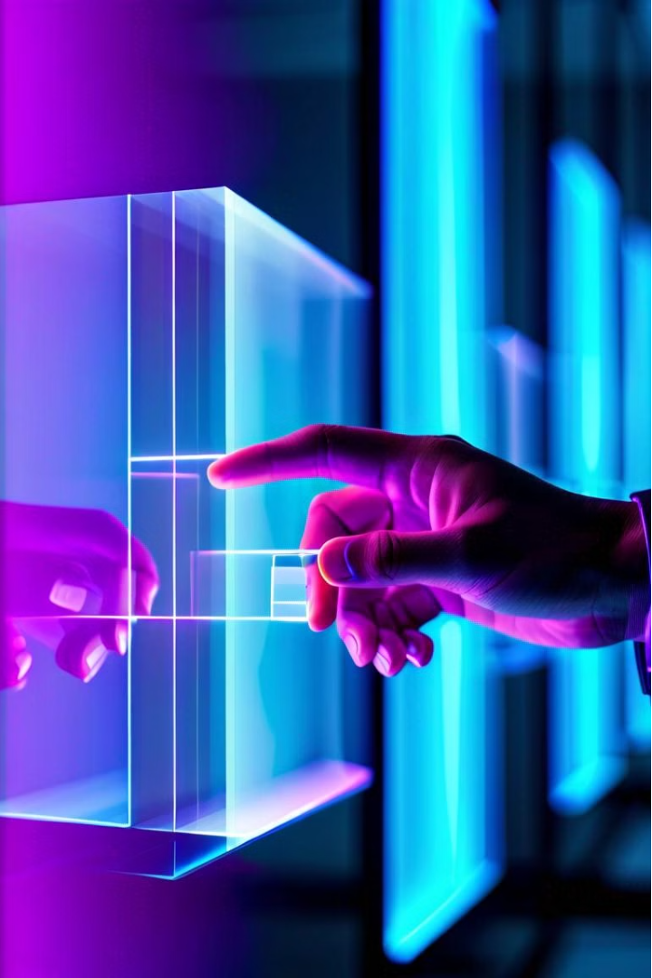
AI-Based Mouse Controller: A Revolution in Human-Computer Interaction
Imagine controlling your computer with just the flick of your wrist. This revolutionary technology harnesses the power of AI to enable intuitive, gesture-based mouse control.
HM
by Hassaan Mehmood

Slide 2
Hand Gesture Recognition: The Key to Intuitive Control
1
Natural Interaction
2
Enhanced Productivity
Hand gestures are a natural and intuitive way to interact with technology. This intuitive approach eliminates the need for a physical mouse, leading to a more comfortable and efficient experience.
Gesture-based controls can streamline tasks, making them faster and easier. This can significantly increase productivity, especially for tasks involving repetitive actions.
3
Accessibility for All
4
The Future of Interaction
Hand gesture recognition provides a more accessible way to interact with computers, opening up possibilities for individuals with physical limitations.
Gesture-based technology is poised to revolutionize how we interact with technology, offering a more natural and engaging experience.

Slide 3
Landmark Tracking: Enabling Real-Time Gesture Detection
Key Points
Real-Time Tracking
Precision and Accuracy
Advanced algorithms analyze a sequence of images to identify specific points on the hand, known as landmarks. These landmarks provide a detailed representation of the hand's position and orientation in space.
The AI continuously tracks these landmarks in real time, allowing for precise and accurate detection of even subtle hand movements. This real-time tracking enables a responsive and dynamic interaction with the computer.
By tracking these key points, the system can accurately interpret hand gestures, ensuring that the mouse responds precisely to your intended actions. This precision is crucial for tasks requiring fine control.

Slide 4




Gesture Mapping: Translating Movements into Mouse Functions
Gesture Recognition
Action Mapping
Mouse Control
The AI analyzes the tracked landmarks and interprets the hand movements as specific gestures.
Each gesture is assigned a specific mouse function, such as clicking, scrolling, or dragging.
The mapped gestures are then translated into corresponding mouse actions, seamlessly controlling the cursor on the screen.

Slide 5
Cursor Control: Seamless Integration of Hand Gestures
Intuitive Navigation
Dynamic Scrolling
Simple gestures, such as swiping or pointing, can be used to move the cursor across the screen, providing a natural and intuitive way to navigate.
Gestures, such as pinching or rotating, can be used to scroll through documents or web pages, providing a smooth and responsive scrolling experience.
1
2
3
4
Precise Selection
Personalized Controls
Specific gestures can be mapped to perform precise actions like clicking on buttons or selecting text. This precision eliminates the need for manual clicking, enhancing efficiency.
Users can customize the gestures and their corresponding actions, tailoring the system to their specific needs and preferences.

Slide 6
Precision and Efficiency: The Benefits of AI-Powered Mouse Control
Enhanced Accuracy
Increased Speed
AI-powered gesture recognition allows for precise control of the mouse, leading to more accurate and efficient actions.
Gesture-based interactions can be faster than traditional mouse methods, leading to increased speed and productivity.
Reduced Strain
Enhanced User Experience
Eliminating the need for a physical mouse can reduce hand and wrist strain, leading to a more comfortable computing experience.
The intuitive nature of gesture control creates a more enjoyable and engaging computing experience, enhancing user satisfaction.

Slide 7
Potential Applications: Revolutionizing Human-Computer Interaction
Gaming
Immersive and intuitive game controls, enhancing player engagement and experience.
Design & 3D Modeling
Precise and dynamic control for creating and manipulating 3D models, enabling more intuitive and creative workflows.
Virtual Reality
Seamless integration of hand gestures into VR environments, creating a more natural and immersive experience.
Accessibility Tools
Providing a more accessible way for individuals with disabilities to interact with computers and other devices.

Slide 8

Conclusion: The Future of Gesture-Based Computing
AI-based mouse control is poised to revolutionize the way we interact with computers, offering a more intuitive, efficient, and accessible experience. As technology advances, we can expect to see even more innovative applications of gesture-based computing, shaping the future of human-computer interaction.

